Slide 1
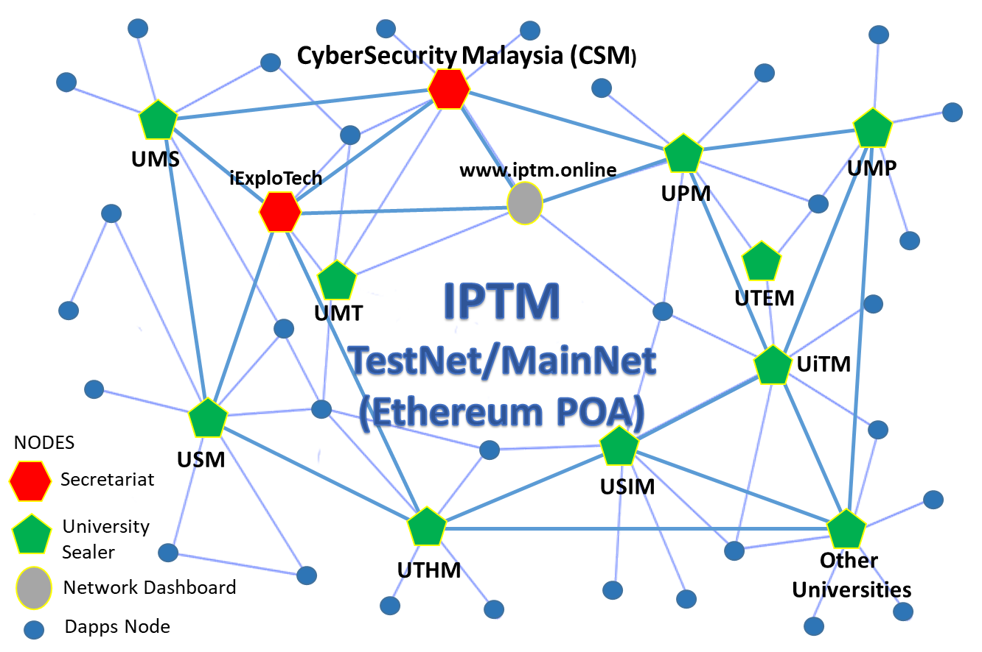
Overview: IPTM TestNet 2020
1. What is IPTM TestNet?
Collaboration between researchers in IPT to establish Malaysian blockchain (BC) network. Everyone contribute and use this BC platform for joint research and development of smart contract and DApps.
2. How do I participant?
Setup Sealer Node: Only one for every IPT
Setup Normal Node: Everyone from IPT can setup, join network, develop smart contract, Web3 mobile DApps etc.
3. Who IPTM’s Secretariat?
CyberSecurity Malaysia: Pn. Hazlin, Pn. Isma etc.
iExploTech (technical support): Dr. Mohd Anuar & Prof. Ramlan.
Gatekeeper of IPTM Sealer Nodes: Every participated IPT has at least two representatives.
4. How to setup a sealer or normal node?
Refer the following manual at GitHub:
https://github.com/iexplotech/IPTM_MyManual
5. Who I want to contact for any questions:
Technical: Dr. Mohd Anuar
Technology Advisory: Prof. Ramlan
Security Policy and Testing: Pn. Hazlin or Pn. Isma (Cryptography Department)

Slide 2
Account Managements
IPTM TestNet Accounts
0
10 million ethers
1 billion tokens
Transfer IPTM Ether & Token (1 Ether == MYR 100 & 1 Token == MYR 1)
0
Root Account
Hold the Entire IPTM’s Ether & Token
Responsible: IPTM’s Trusteed
Trusteed: CyberSecurity Malaysia (CSM)
3
2
1
Sealer Node Account
Hold non-negligible Ether by Writing Transactions in Blockchain Ledger
Responsible: Gatekeeper for IPTM Sealer Nodes, Voting ADD/REMOVE Sealer Nodes
Trusteed: Staff/Researcher in University
1
Default Account
Temporary Hold Small Amount of IPTM Ether & Token.
Responsible: Distribute Ether & Token to All IPTM’s Representatives or Universities
Trusteed: CSM & iExploTech
3
4
2
IPTM Representative Account
Temporary Hold Small Amount of IPTM Ether & Token.
Responsible: Distribute Ether & Token to Faculty members in University
Trusteed: Staff/Researcher in University
4
Staff and Student Account
Hold Small Amount of IPTM Ether & Token for R&D projects: DLT, Blockchain & Dapps
Responsible: Research, Design, Develop, and Testing Dapps in IPTM Testnet
Trusteed: Staff/Researcher and Student in University
*Draft 24 Sept 2019
Need feedback from everyone

Slide 3


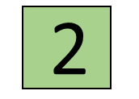
Account Managements
How IPTM TestNet generate and distribute ethers?
1. Initialized with 10,000,00 ethers in IPTM TestNet genesis (configuration) file at block 0.
2. When you want to consume IPTM ether or IPTM Token for you BC project, please keep in mind on the following assumption of the scale value:
1 IPTM Ether == MYR 100
1 IPTM Token == MYR 1
3. Root Account holds the entire IPTM ethers or Tokens.
4. Root Account distributed ethers by stages through Default Account.
5. Default Account distributes ethers to all IPTM Representative Account through a simple account validation process as the following 2 steps:
Step 1:
Individual(s) that in charge the IPTM Representative Account will contact IPTM Secretariat to request some ether for their IPT. You need to submit your account (eth address) that will be used as the IPTM Representative Account for your IPT. Restricted! There is only one account for every IPT. This person will responsible to distribute ethers to all users (Normal Nodes) in their university.

Slide 4
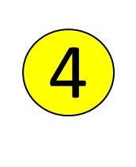
Account Managements cont.
Step 2:
For the first time, before IPTM Secretariat transfer the requested ethers from the Default Account to the Representative Account ( ):
The Secretariat will transfer 0.001 ether to Representative Account as PING.
Then, the Representative Account must transfer 0.0001 ether to the Default Account as PONG.
After verifying the PING-PONG process, IPTM Secretariat will transfer a huge amount of ethers to the Representative Account.
6. In the earlier stage of IPTM TestNet 2020, the individual(s) that responsible for the IPTM Representative Account and Sealer Node Account could be the same person. Later on when there are many savvy BC practitioners in your IPT, we recommended to separate the responsibility by different individuals or groups.
7. If you are running as Normal Node, you may request 1 or more ether from your IPTM Representative Account at your IPT, not directly from IPTM Secretariat. The person in charge at your IPT will request identity verification as your are registered as a student or staff at your university. Outsider is not allow to get any ether or token from your university.
8. We recommended at maximum of 1 ether to be transferred to Normal Account that not involving to any BC project development. These people just want to use or pay a gas fee of BC transactions for any deployed smart contract in IPTM TestNet 2020. Probably 0.01 ether is enough to pay some BC gases.

Slide 5
Account Managements cont.
9. How much BC processing can be done if you have 1 ether as a gas for Ethereum smart contract?
Estimated: You can submit/deploy around 100 to 1,000 smart contracts into IPTM TestNet to burn 1 ether. Probably 1,000 to 10,000 smart contract transactions to burn 1 ether.
Simple Ethereum transaction fee is 0.000021 ether or (21000 GWei or 21000000000000 Wei) and this is the minimum - contract interactions are taking more gas. The gas price is paid by the sender of the transaction.
10. Who get the gas fee?
Sealer node that perform mining (write current block) for the transaction will get the gas fee.

Slide 6
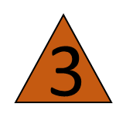
Node Managements
Two types of IPTM geth node: Sealer Node and Normal Node
IPTM Sealer Node:
1. Setup by IPT representative or gatekeeper. Must be a permanent staff of IPT not student!
2. You must setup IPTM Bootnode Client. This will allow this node automatically find and connect other nodes using P2P in IPTM TestNet.
3. Only one Sealer Node and one Sealer Account for every IPT.
4. IPTM secretariat will organize voting event to add new node as Sealer Node (or Signer Node). E.g:
clique.propose("account_or_address_of_your_node", true)
5. This Sealer Node will continuously mining or writing new blocks (ledgers). IPT representative responsible to keep this node running 24 hours.
6. Restricted! no other blockchain transactions are allowed using the Sealer Node!

Slide 7
Node Managements
IPTM Normal Node:
1. Setup by everyone that wants to use IPTM Testnet 2020 as blockchain (BC) network. This including that if you wants to deploy your smart contract or DApps in this BC network.
2. You must setup IPTM Bootnode Client. This will allow this node automatically find and connect other nodes using P2P in IPTM TestNet.
3. You may turn online of turn offline this node as required for your project. When you turn it online, it will sync with latest blocks by P2P with other nodes, especially Sealer Nodes.
4. All blockchain transactions such as transfer ethers, tokens, smart contracts etc. must be done using this node, not the Sealer Node!
5. To perform blockchain transactions in IPTM TestNet, you need some ethers. You may request some ether from your IPTM Representative Account at your IPT.

